Slide 1
Bioeconomy Ireland Week 2024 Development of Peatland Based Bioeconomy Demonstration Hubs
Dr. Emer O’Neill

Slide 2
The Bioeconomy
“Using renewable biological resources from land and sea, like crops, forests, fish, animals and micro-organisms, to produce food, materials and energy” which in turn “will help accelerate the progress towards a circular and low-carbon economy”.
Evolution relatively recent – Expanding rapidly
Driven by shift towards sustainable and low-carbon solutions
Greater environmental awareness & more evident impacts of climate change
More sustainable practices – Efficiency, waste reduction & environmental conservation

Slide 3
The Irish Bioeconomy
Create value from renewable biological resources while reducing reliance on fossil fuels & lowering environmental impact
Built on foundation of oldest industries – vital to economy
Linear – Circular
Harvest
Use
Waste
Harvest
Use
Recycle Waste
Reuse

Slide 4
Mount Lucas
Mount Lucas – Bord na Mona
Wind Farm
National Construction Training Facility
Walking trails, sensory gardens
Peatland based aquaculture

Slide 5
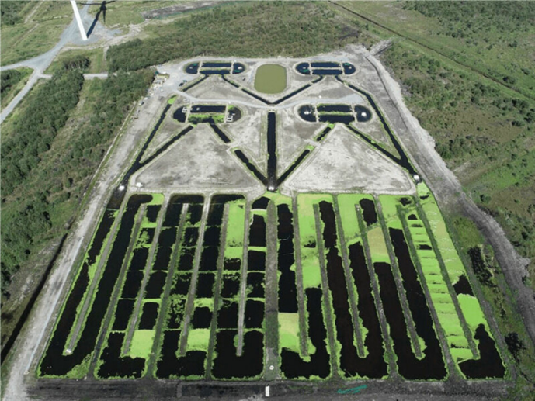
Mount Lucas Fish Farm
Land Use Change - Mount Lucas Aquaculture Project
Bord na Mona & BIM (~2018/2019) – Trial farm
5.4 ha., 4 D-end ponds & 16 lagoon channels
Rainbow Trout, Brown Trout, European Perch – Pill Ponds
Native duckweed
Semi closed, recirculating IMTA process

Slide 6
BioMDJT Project
Feasibility & Scoping
Mount Lucas Aquaculture Site – Just Transition
SME’s, Local Communities, Academia & Researchers, LA & Policy
BP for Development of peatland based bioeconomy demonstration sites
Visit BioMDJT Project – TUS (https://tus.ie/rdi/research/centres-groups/empower-eco/biomdjt-project/) for more information.

Slide 7
Bioeconomy Demonstration Hub

Slide 8
Dr. Emer O’Neill
086-3764557 / emer.oneill@tus.ie
Senior Postdoctoral Researcher Research Fellow Senior Postdoctoral Researcher
Faculty of Science & Health Empower Eco Sustainability Hub Mount Lucas Bioeconomy Demonstration Hub
Technological University of the Shannon, Midlands Research Innovation Centre Mount Lucas Wind Farm
Midlands Campus TUS East Midlands Campus Mount Lucas
University Road University Road Co. Offaly
Athlone Athlone R35 RX00
Co Westmeath Co. Westmeath
N37 HD68 N37 F6D7

