Slide 1


PROCUREMENT OVERVIEW &
SOLE SUPPLIER JUSTIFICATION – Q&A
Procurement Team
Notes:
No notes

Slide 2
Procurement Thresholds
1
2
3
4
≤ €5,000
>€5,000 ≤ €25,000
>€25,000 < €50,000
€50,000 plus
1 Written quote
3 Written quotes
Evaluate quotes based on specification & criteria in the quote request
Request for quote required to be run by Procurement Team contact procurement@tus.ie
Tender required contact procurement@tus.ie
Sole Supplier form requirements
Note: Figures quoted are excl of VAT & the full contract/order values needs to be considered.
See notes below for additional info.
≤ €5,000 excl. VAT no form required, 1 written quote
≥ €5,000 excl. VAT Sole Supplier form required only if there is no other supplier option
Notes:
Quote request - >€5,000 ≤ €25,000
It’s a lighter, quicker process than a full tender (for example: email requesting pricing/other requirements)
The buyer sends a short description of what they need (the product/service, quantity, delivery, etc.). Ensure that a response deadline is included in the quote request to all parties.
Suppliers reply with their prices and terms.
The buyer compares the quotes and chooses the supplier that offers the best value (not always just the cheapest).
The process must be fair, transparent, and documented.
All quotes received (minimum 3) should be uploaded to Agresso with the PO requisition. If the preferred supplier did not submit the lowest value quote, then a short note outlining the basis for the selection should also be uploaded

Slide 3


Barry Coleman
Trudy Stack
Jacintha Burns
Trish O’Connell
Contact: procurement@tus.ie
https://tus.ie/procurement-and-contracts/

Slide 4
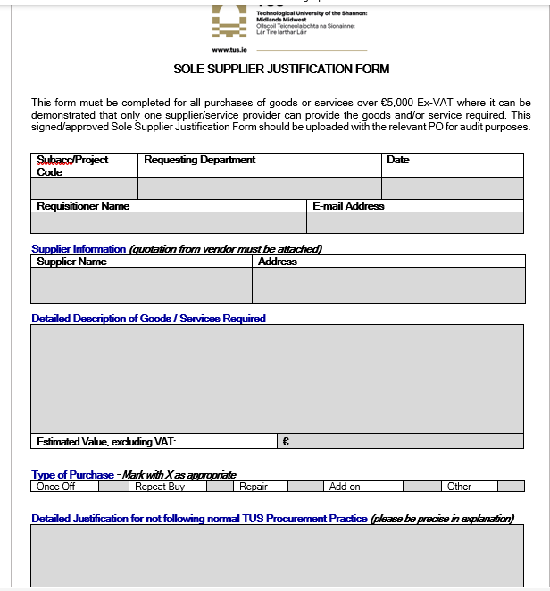
Agenda
Sole Supplier Form in Procurement Process
What is it
When to use it
What’s required

Slide 5
What is a Sole Supplier Justification Form
1
2
3
Formal
Document
One Supplier
Compliance
Your title 05
Formal Document
A formal document used in procurement
Justifies obtaining a quotation from only one Supplier
Supports Transparency and Compliance

Slide 6

When is a Sole Supplier Justification Form used?
01
02
Sole Supplier claims
are exceptions not the rule
Purchases > €5,000
Where only one Supplier
excl. VAT
is capable, suitable or available to deliver the required goods/services

Slide 7
Why is it important
Misuse
1
Prevents misuse of direct awards
Compliance
3
2
Demonstrates compliance with procurement regulations
Risk Management
Protects the buyer from legal or audit challenges
Transparency
4
Documents why a competitive process was not possible

Slide 8
What’s Required on the Form?
Important to note
Required to Complete
Unacceptable
Justification
Sole Supplier forms are not open-ended
Must indicate period covered (e.g., 3 years for licence)
For repeat purchases:
  Complete a new form each year, or
  Clearly state multi-year coverage if relevant
Ensures ongoing compliance and review
Supplier name and details
Description of goods/services
Justification (explain why alternatives are not suitable and confirm that appropriate checks were completed beforehand)
Contract value and duration
Approvals / sign-off
Validity period (e.g., 1 year, or 3 years for licence contracts)

Slide 9
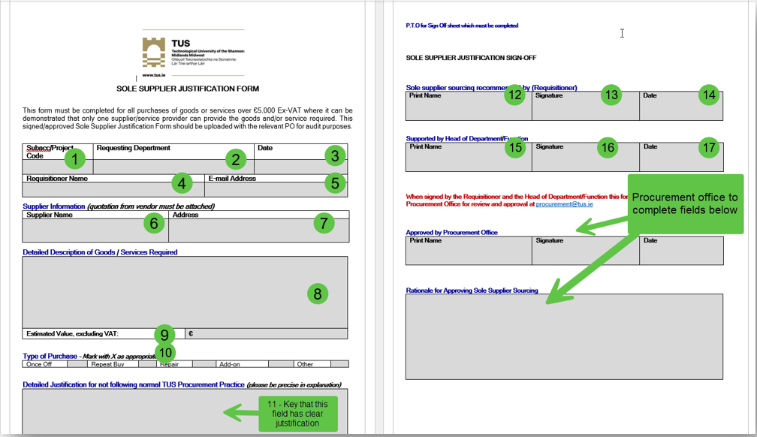
What’s Required on the Form?
Important to note
Required to Complete
Unacceptable
Justification

Slide 10
Good Practice
Example of strong justifications
Good Practice
Unacceptable
Justification
Be specific (e.g., licence, patent, compatibility)
Keep justification brief and factual – focus on what makes the supplier unique in their offering
Attach supporting evidence/market research showing no competition where possible
Always confirm validity period of the form and renew if required (renewals are not the responsibility of the Procurement Team)
Only Manufacturer – This supplier is the sole producer of the required goods; no alternatives exist in the market.
Exclusive Rights – The supplier holds exclusive patents/licensing, making them the only source available.
Note: In all cases it must be clearly and specifically outlined what is unique about the goods/services being provided by the sole supplier

Slide 11
Common Pitfalls
Unacceptable
Justification
What to watch out for
Examples – what not to add
“We’ve always used this supplier”
“They know our process best”
Supplier is “easier to work with” or more convenient
Assumption that “no one else can do it” without checking the market
“No time to tender”
“They gave us a great deal”
Weak or vague justifications
Using “preferred supplier” as the only reason
Not documenting market checks if performed
Relying solely on supplier claims of being the only supplier

Slide 12
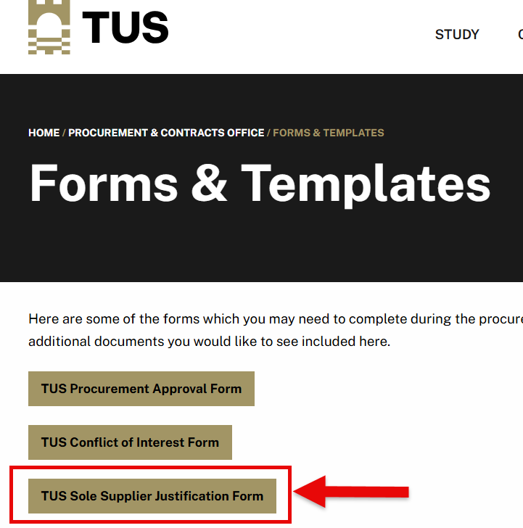

Where to find & send Sole Supplier Justification Form
not to add
What to watch out for
Completed forms should be emailed to Procurement@tus.ie for approval.
When & if approved the form should be uploaded to Agresso.
Always ensure the most recent version of the form is being uploaded in Agresso.
Unacceptable
Justification
https://tus.ie/procurement-and-contracts/forms-and-templates/

Slide 13
Summary
1
3
Exceptions
Over €5,000
Be clear & Justify
Audit Ready
Sole Supplier = exception, not the rule
Required for purchased over €5,000 excl VAT
Must be clear, justified, and time-bound
Protects TUS and the procurement process
2
4

