Slide 1
Utilising legal technology to enhance productivity
Laurencia Maguire
Notes:
Good afternoon, everyone my name is Laurencia Maguire, and I am speaking on behalf of LEAP Legal. how we are harnessning the power of technology to enhance productivity in the legal profession.

Slide 2
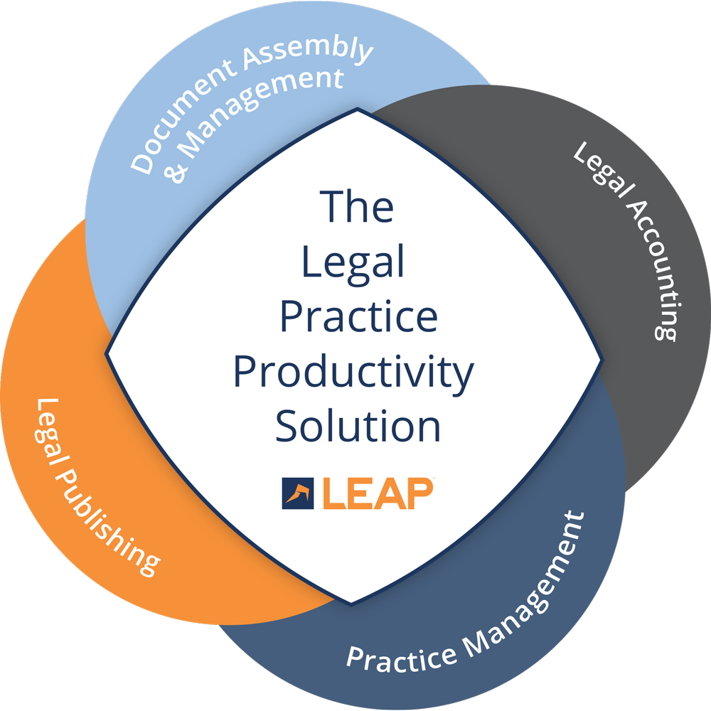
Everything you need to run a law firm
LEAP occupies a unique position in the legal software market.
Practice management
Legal accounting attributes
Document assembly and management
Legal publishing assets
…in a single solution.
Notes:
LEAP occupies a unique place within the legal software market, we offer not only practice management, but legal publishing, document assembly and legal accounting all under one integrated platform
Our main goal is to make it easier for small to mid-sized firms to manage their matters from a single all-in-one solution. A Legal Practice Productivity Solution.

Slide 3
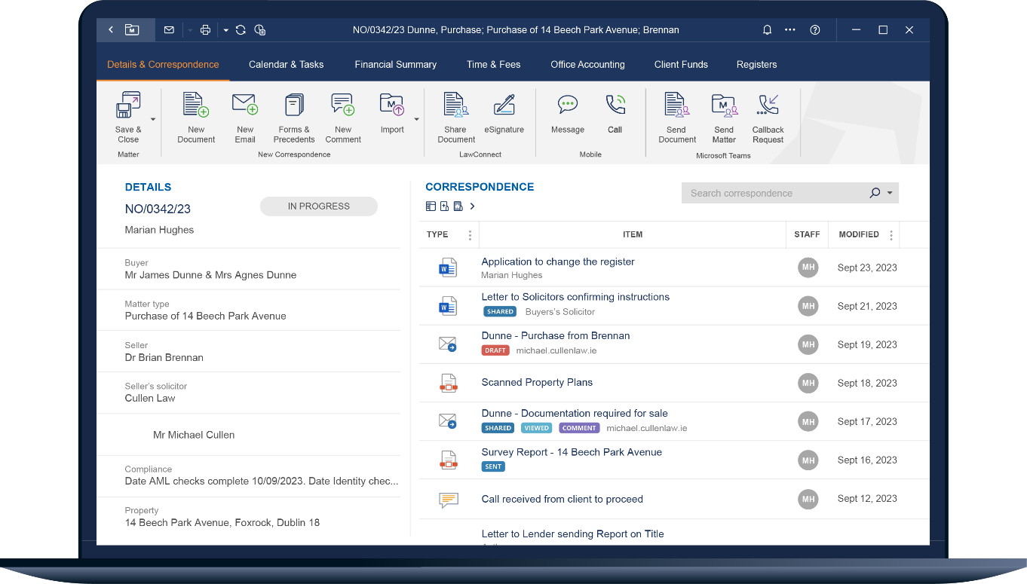
Developed with solicitors in mind
LEAP is the world's largest provider of legal cloud software for law firms
Founded in Australia in 1992
66,000+ users globally, with over 400 firms in Ireland
30+ years of innovation
Investing over €15 million a year into research and development
Notes:
Now moving onto a bit of background information about LEAP,
We now stand as one of the worlds largest provider legal cloud software within the legal profession
We were founded over 30 years ago originating from Australia,
since then, we have over 66,000 LEAPsters globally, Within Ireland Specifically, we now have over 400 firms adopting LEAP within their practice
Each year we invest over €15 million research and development so that LEAP remains at forefront of cutting edge. We provide continual updates and enhancements to help future from legal practices and remain attune to the ever-changing needs of our clients

Slide 4
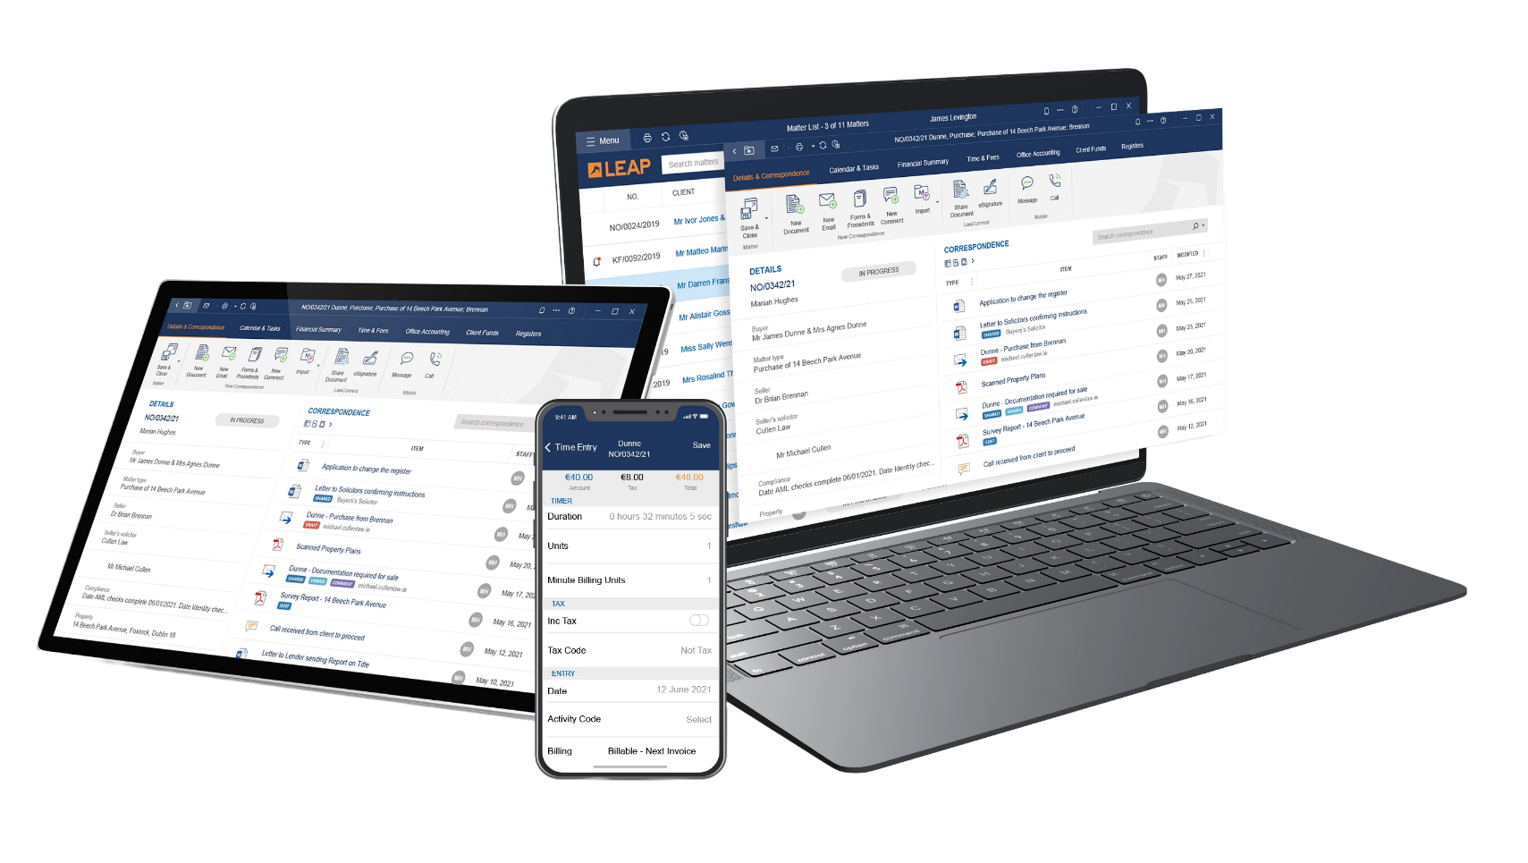
Providing law firms a single source of truth
Work is no longer a place, but an activity with LEAP
One version of the truth
Work from anywhere on any device
Ability to work offline
Cloud based and no servers
Reduced IT expenses
Real-time case activity and client information
Notes:
As a result of this continuous research and development invested into LEAP yearly, we can provide a single source of truth as a true cloud all in one solution
Work is no longer confined to a physical space; it's an activity that can be conducted from anywhere, at any time, and on any device.
With LEAP, everyone in a firm is working with one version of the truth. Solicitors have access to real-time case activity and client information, whether they’re in the office, at home, or on the go.
This integrated approach ensures that your firm operates efficiently, collaboratively, and with the most up-to-date information at your fingertips.

Slide 5
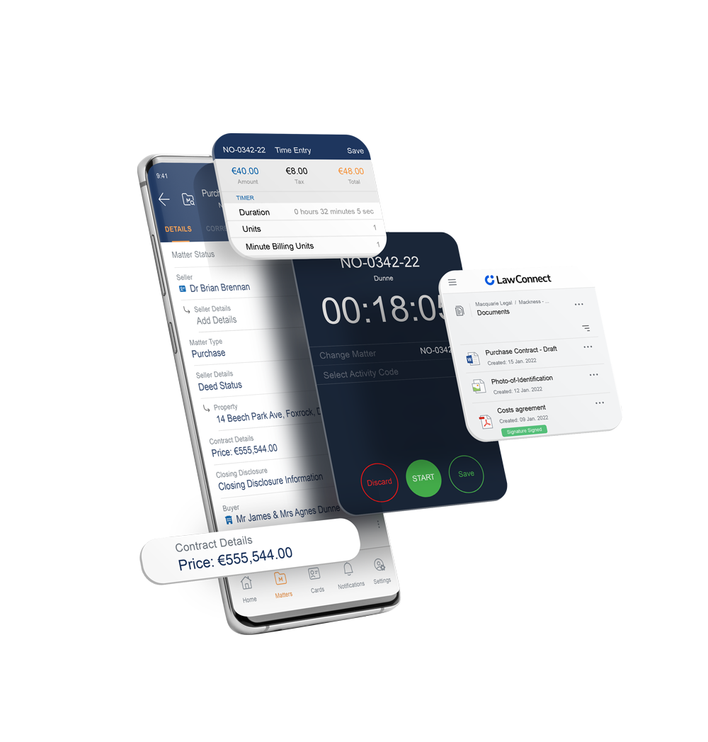
Work anywhere at any time with the LEAP Mobile App
Manage matters remotely
Send emails, create time entries and view documents from any device whether you’re in the office, at home, attending court or out meeting clients
Scan documents on-the-go
Time record from your mobile
Accurately edit documents and include file notes when time is of the essence, using cutting-edge voice-to-text technology
Notes:
At your fingertips, you’ll find LEAP’s mobile application, LEAP makes it easy to work on your matters, whether you’re in the office, at home, attending court or out meeting clients.
It provides solicitors with the ability to manage matters remotely , scan documents on the go , time record from your mobile, and view documents from any device.
These features combine to provide legal professionals with the flexibility and convenience they need to manage their workload effectively and deliver exceptional service to their clients.

Slide 6
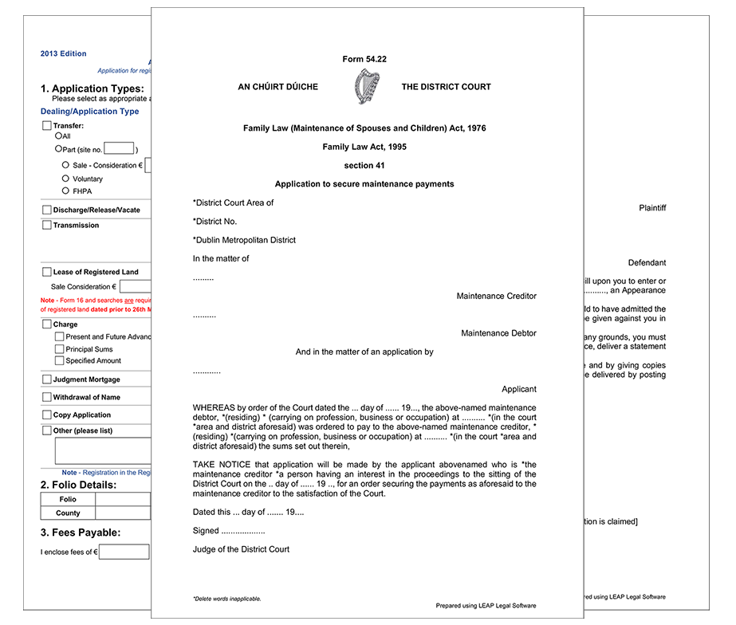
Automated document preparation
Automatically updated and highly integrated Irish legal forms and precedents
Up-to-date and highly integrated legal forms and precedents allow law firms to work smarter, not harder
Input matter information once into your electronic matter and have it populate automatically into all your documents, including LEAP’s library of 1,500+ official legal forms
Use eSignatures to securely send any document generated from LEAP to be electronically signed
Notes:
Now that we've explored LEAP's mobile application, let's move onto how LEAP can also streamline doc preparation for legal professionals
One of the key features of LEAP is its ability to automatically update and integrate Irish legal forms and precedents.
These up-to-date and highly integrated legal forms and precedents allow law firms to streamline their workflows and ensure accuracy in their documents.
With LEAP, you only need to input matter information once into your electronic matter, and it will automatically populate into all your documents, including LEAP's extensive library of over 1,500 official legal forms.
Additionally, LEAP offers the convenience of eSignatures, allowing you to securely send any document generated from LEAP to be electronically signed.

Slide 7
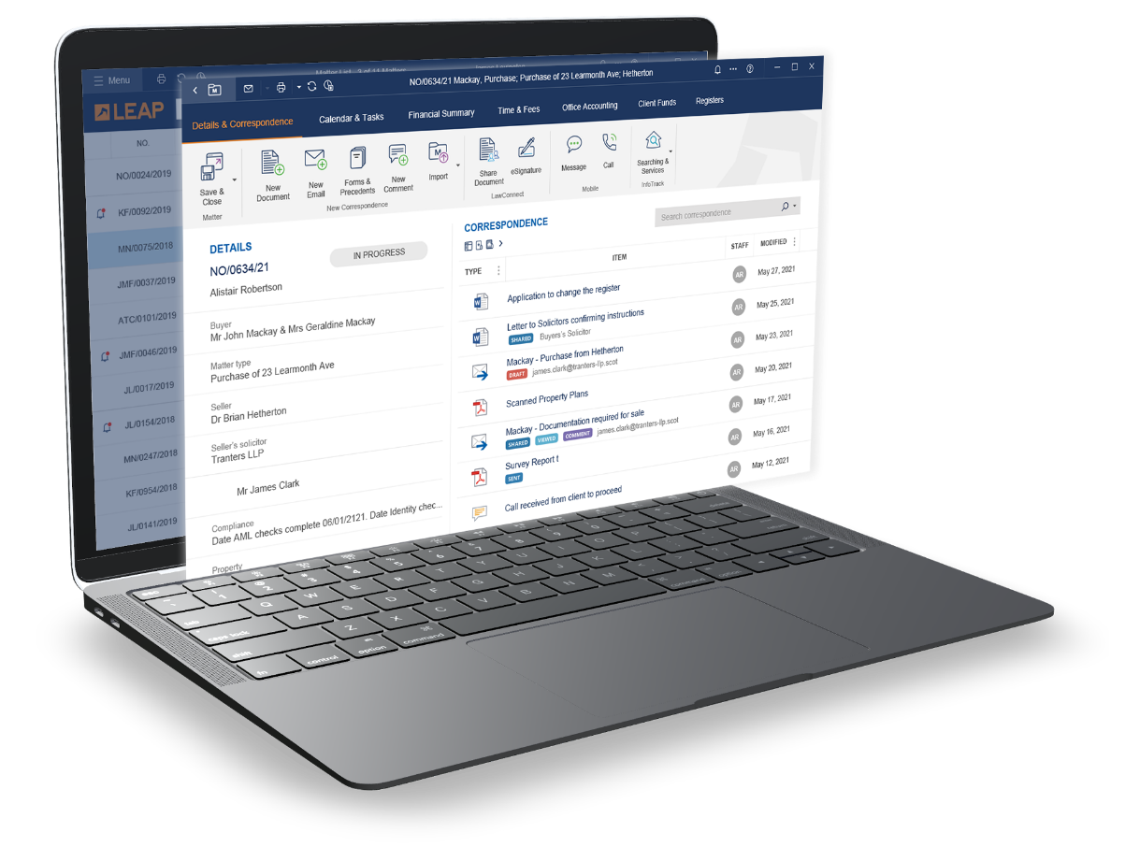
Data security
World-class data centres protect your practice
All LEAP data is securely stored on servers built on the Amazon Web Services (AWS) platform
Both Transport Layer Security (TLS) and RSA encryption, used by the banking sector
Continually backs up your data which is replicated across three separate data centres in the AWS Dublin region
LEAP Legal Software has earned the globally recognized SOC 2 Type I certification
Notes:
All LEAP data is securely stored on servers built on Amazon Web Services (AWS) platform, currently stored in Dublin.
AWS prioritizes security, offering data centres designed to meet the needs of the most security-conscious organizations, with NASA as one of their notable clients.
LEAP uses both Transport Layer Security (TLS) and RSA encryption. Industry standard technologies and it guarantees all communication between your computer and the host server is encrypted and protected from interception.
This is considered the gold standard for security compliance for software-as-a-service.
It requires us to establish and follow strict information security policies and procedures, ensuring the security of customer data.
The security and confidentiality of our users’ data has always been a top priority. This rigorous, independent assessment of our internal security controls serves as validation of our dedication and adherence to the highest standards for security and confidentiality to protect our users’ data.

Slide 8
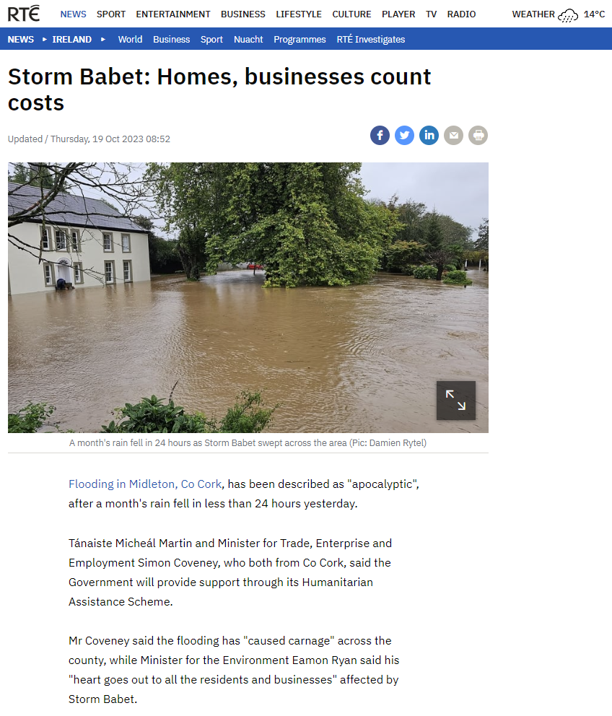
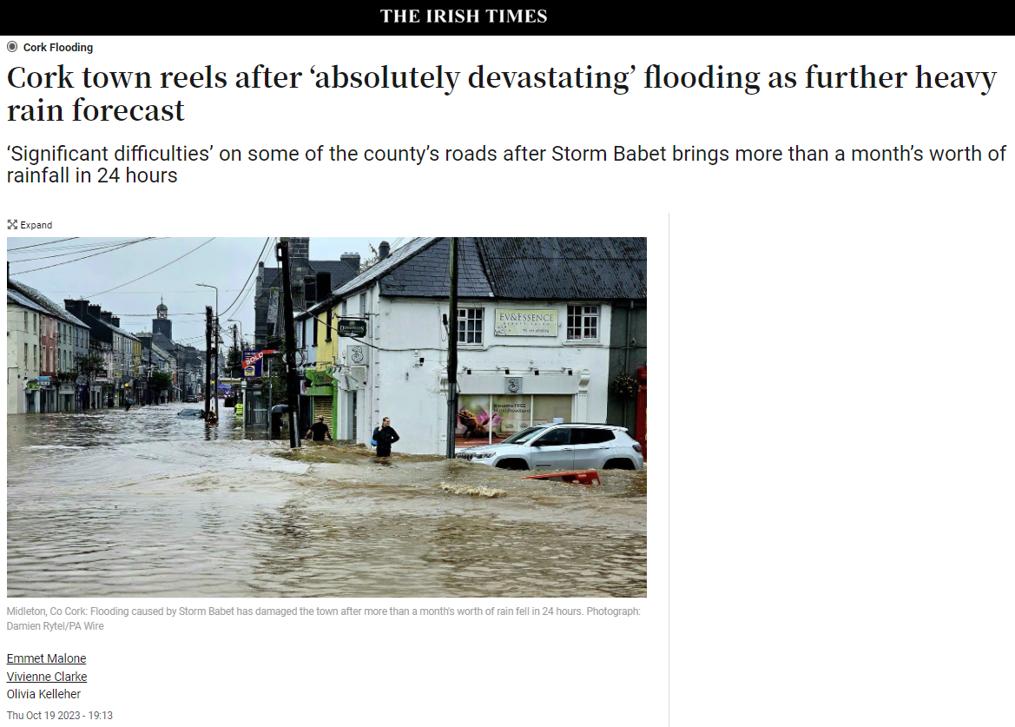
Peace of mind
Notes:
those reliant on server-based or paper-based systems- sufferering significant losses, as all their data was stored in one physical location, vulnerable to natural disasters like floods.
Firms using LEAP (in relation to storage of their data) remained unaffected by the recent flooding in Cork. This is because their critical data was securely stored off-site on the cloud
firms adopting traditional server-based or paper-based systems, which store data locally, can be vulnerable to not only security risks but also natural disasters like this. Being on the cloud , data remains accessible and intact.

Slide 9
LEAP client testimonials
“Transitioning from paper to digital software can be quite daunting, it was very seamless, the training provided was excellent”
FSK Solicitors
“LEAP has become essential for the day to day running of our business”
Staunton Caulfield & Co. Solicitors
“We are able to engage with our client in a more efficient and cost effective way which sets us apart form those paper based firms”
GCS Solicitors
“LEAP creates this greater awareness, this greater control over your content and this greater ability to reply to your clients in a much more timely fashion, because the information is available at the click of the button”
MP Moloney
Notes:
On the screen you will see a selection of quotes from our customers based across Ireland.
We now have 400 firms using our software in Ireland, LEAP is helping law firms to work more efficiently and provide outstanding service to clients.

Slide 10
Thank you
Laurencia Maguire
laurencia.maguire@leapsoftware.ie | linkedin.com/in/laurencia-maguire/
Notes:
So there it is , The legal practice productivity solution from Leap, all you need to run a law firm.
Thank you very much for your time today.
If you wish to discuss this or anything else about Leap then please reach out to me via email

