Slide 1
AI for judicial decision-making: implications for the future of open justice
Dr Brian Barry
brian.barry@tcd.ie
Notes:
This presentation considers whether the principle of open justice needs to be reconsidered in light of AI tools for judicial or other legal decision-making becoming increasingly prevalent in many jurisdictions. On the Columbian Constitutional Court PretorIA, an AI system is used for automating docket control of human rights cases. In Buenos Aires, a system called Prometea drafts opinions on low-level criminal law cases.
In the US, the COMPAS recidivism risk tool generates a recidivism risk score that judges rely on to sentence criminals. In China, the judicial system has rapidly and enthusiastically integrated AI tools that play an integral role in assisting judges in determining liability and quantum in a range of different legal dispute types. Judges in Columbia, India, Pakistan and the UK have all relied on Chat GPT for drafting judgments. One UK Court of Appeal judge described ChatGPT as “jolly good”.
I’m not here to talk about bias, discrimination, error in AI systems: only this: what does increased reliance on AI tools for legal decision-making mean for open justice? The crux of this piece is to consider whether open justice – the ideals of public scrutiny of the judicial process in open, public court – is dead in the era of AI, what can be done to ensure transparency and accountability in this new AI era.

Slide 2
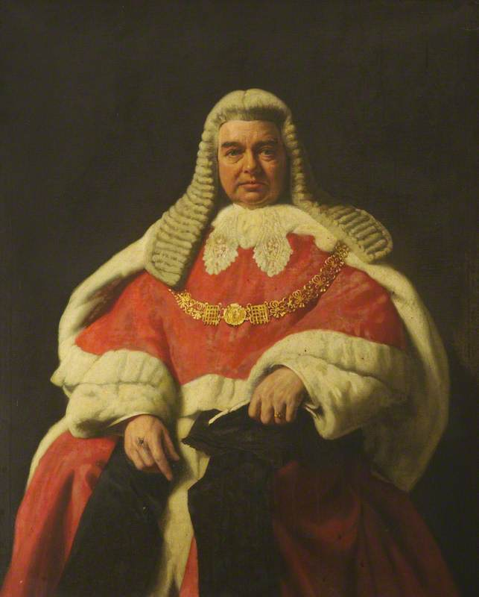
The principle of open justice
“…justice should not only be done, but should manifestly and undoubtedly be seen to be done.”
R v Sussex Justices, [1924] 1 KB 256
Notes:
Lord Hewart’s aphorism on the requirement of open justice, that justice must be seen to be done, has endured over the decades. There are other expressions: “justice is not a cloistered virtue,” “[p]ublicity is the very soul of justice” … among others.

Slide 3
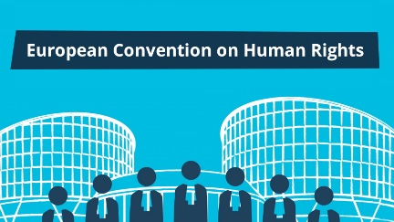
Legal sources of the principle of open justice
Article 34 Constitution of Ireland
Article 6 ECHR
Article 14 International Covenant on Civil and Political Rights
Case Law
Notes:
This pervasive axiom enjoys constitutional status. It is a mainstay in international human rights instruments. It has evolved through case law to protect the publicity of justice initially in criminal cases, then in civil trials and other contexts.

Slide 4
What rules flow from the principle of open justice?
Consensus
Judicial proceedings are conducted and decisions are pronounced in open public court
Evidence is communicated publicly
Fair and accurate reporting not interfered with
Developing jurisprudence
Duty to give reasons
Notes:
What rules flow from the principle of open justice?
There is some consensus: that judicial proceedings are conducted and decisions pronounced in open public court, that evidence is communicated publicly, and that fair and accurate reporting of judicial proceedings should not be interfered with.
Alongside commonly understood rules and caveats to them, there is a sustainable argument that the duty to give reasons for a judicial decision flows from the principle of open justice. Judges are expected to explain their thought processes (how they expended cognitive effort to arrive at their decisions. This isn’t just for the parties, this is for the public. And common law cannot develop without judges providing reasons for their decisions.
So, how do these rules fare - public justice in an open public court and the duty to give reasons – when AI is part of the process?

Slide 5
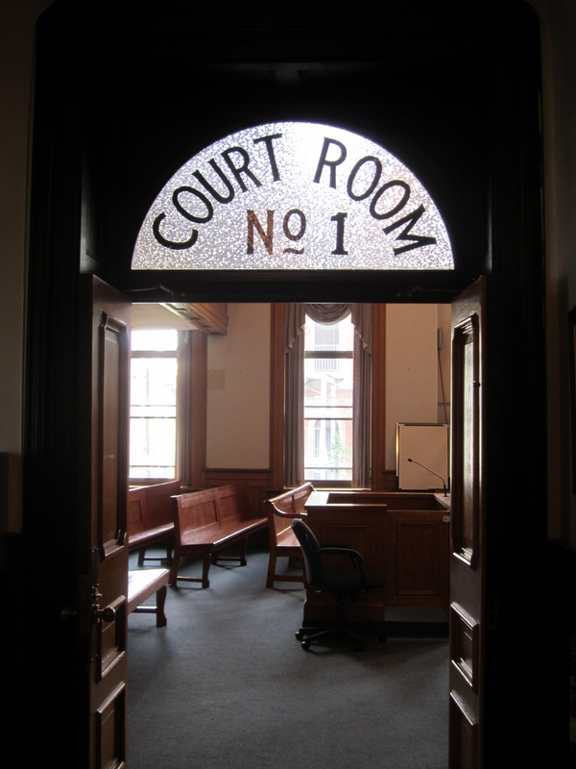
Is open justice (and its rules) compatible with AI?
Public justice…
Notes:
The concept of ‘public’ justice in ‘open public court’ has undoubtedly evolved. The COVID-19 pandemic shifted courts online.
There’s scope for justice to be realised in non-physical environments.
The idea here is that open public court allows for “public scrutiny” – that’s the rationale.
But can it really be said that the public can truly scrutinise justice when an AI tool is central to the process in assisting judges in their judicial decision-making process.
Inputting information into an AI tool, and then it providing an output recommending a legal decision is anathema, contradictory to the ideal of open, public court.
That’s unsettling. So, as I’ll continue, we need to reconsider what we mean by public-facing justice and seek other values that can provide some level of trust and accountability through process transparency.

Slide 6
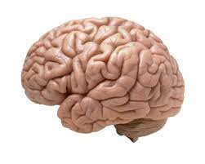
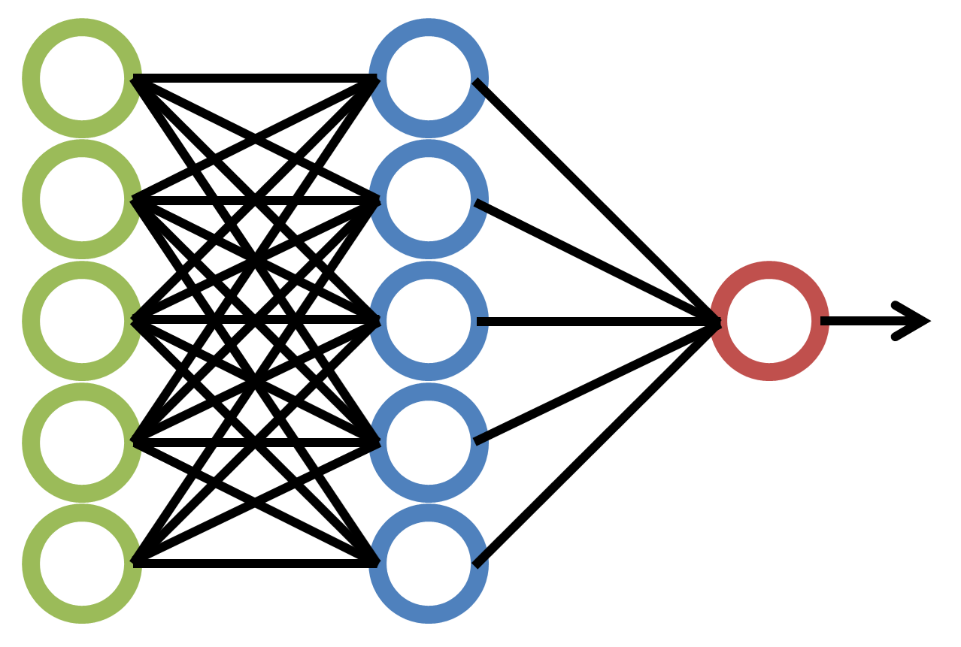
Is open justice (and its rules) compatible with AI?
Duty to give reasons
Legal decision
Notes:
What about the duty to give reasons which, as I mentioned, is often seen as a rule that falls under the principle of open justice.
If judges must provide reasons for their decisions as part of open justice, to date that has meant that their judgment must reflect an exercise of cognitive grunt work. Judicial reasoning has been described as a combination of “the process of thought by which a judge reaches a conclusion”. Another notes it requires “a variety of cognitive techniques, involving engaging in induction and analogy, and engaging in argumentation.” Others say “moral judgment” and a judge’s “own belief in the legitimacy” all comes into judicial reasoning.
Of course, AI systems do not operate a “process of thought” they do not adopt “cognitive techniques” they can’t engage in “moral judgment” or believe in their convictions. They simply rely on a vast database, algorithms and a deep neural network to assess the probability that a particular output is a correct one based on a particular input.
Text judgments by AI will soon mimic human judgments. I’m not saying that’s a good thing. It’s just that it will happen. Soon. But, of course, this is reasoning of a different kind. Van Der Haegen observes that this amounts to “[r]eplacing human reasoning by algorithmic reasoning” that necessarily means that “correlation takes the place of causation” which “debases the value of legal rules: they are treated as mere factors in an algorithm”
Should we be pragmatic:
Volokh offers a pragmatic perspective, asking whether those in dispute should “consider the output, not the method” and contends that [“i]f a system reliably yields opinions that we view as sound, we should accept it, without insisting on some predetermined structure for how the opinions are produced.”
Where to draw the line?

Slide 7
The principle of open justice… in an AI era?
How can justice “be seen to be done...” in the era of AI legal decision-making?
Recalibrate “open justice” …
Notes:
So, what would Lord Hewart respond to this question: how can justice be seen to be done in the era of AI judicial and other legal decision-making?
I suggest that we need to go back to first principles, that open justice, at its core, is about facilitating transparency and public scrutiny. And we can draw from two theories beyond law to help maintain the essence of open justice where AI is used to recommend, or make legal decisions.
It’s not about discarding the ideas that justice should, by default, be administered in open court, or that judges ought to dismiss the need to give reasons for decisions.

Slide 8
Draw from two theories / areas of literature
Procedural Justice (Thibuat and Walker)
Applied to algorithmic decision-making (Lee et al).
Explainable AI (XAI)
Two strands (Xu et al)
Standards clarity
Explanation of decision outcomes
Transparency design
Post-hoc explanation
Algorithmic transparency
Article 13 and 28b EU AI Act: “Transparency” and ”sufficiently detailed” summary of the use of training data for foundation models.
Decision explanations
Article 13(1) GDPR: “meaningful information about the logic involved”
Notes:
The two strands are procedural justice theory at the intersection of social psychology and law.
And explainable AI from technology literature.
Procedural justice (sounds like a legal concept) but it’s actually a very reach and entirely useful body of literature from psychology: it essentially examines the psychological levers of how and when do people feel that a process that affects them is fair.
Building on formative, influential work by Thibuat and Walker, Lee et al, ask what amounts to procedural justice when algorithms are used to make decisions?
They identify transparency in the process and control over the process as two key pillars of procedural justice when AI is used to make or help with making a decision. When we focus on the transparency element, a singularly important factor is what they call - standards clarity - a clear communication of how the rules and methods the algorithm decision-maker uses to make decisions,– and, secondly, that an “explanation of specific decision outcomes” is provided. Insofar as control is important, the ability of the affected parties to input the data is a critical aspect of control. Adversarial court processes accommodate this: you provide the court with input data on which to make decisions: affidavits, legal submissions, case law etc. So, you get to control the flow of information on which the decision-maker makes its decision.
Interestingly, when we turn to the literature on “explainable AI or XAI, again, two near-identical concepts emerge. Xu et al emphasise that XAI has two strands: “transparency design” (i.e. that there’s explanability in the design of the algorithm) and “post-hoc explanation” (i.e. explanations are afforded to those at the receiving end of the decision).
So, these two separate strands of literature – psychology and a subdomain of computer science - seem to be saying much the same thing. Getting to the nub of it, both seem to be asking for transparency in
a) How the algorithm works generally, and b) how it came to make the specific decision that affects you.
Or, what we’ll call algorithmic transparency and decision explanations.
I think this is a good bedrock on which to build open justice for the AI era. And, interestingly, there are EU legal provisions out there that substantiate this claim: for instance, as regards algorithmic transparency: the latest draft of the proposed EU AI Act Article 13 requires that high-risk AI systems (which captures systems for judicial decision-making) shall be designed and developed in such a way to ensure that their operation is “sufficiently transparent”. Or, the EU Parliament’s draft, Article 28a that, for foundation models like ChatGPT, that their creators provide a “sufficiently detailed” summary of how they use training data.
As for decision explanations, the GDPR, through a combination of Articles 4, 13 and 21, provides a legal right to an explanation when automated decision-making makes a profiling decision where one’s personal data is collected. Legal proceedings take your personal data, you are profiled (your behaviour is evaluated). GDPR demands that you are entitled to “meaningful information about the logic involved” in the decision by the automated decision-making tool.
Basically, a decision explanation.
So, where open public court and the judge’s duty to give reasons are incompatible and can’t be adhered to, these two ideas give, hopefully, some principled scaffold around which to build more specific legal rules so that the principle of open justice is at least somewhat satisfied – that the public knows what’s going on when AI is used for legal decision-making

Slide 9
Why this matters…
Notes:
I think this really really matters. This is COMPAS – the sentencing tools. Northpointe own the algorithm. You pop in all the data… and boom

Slide 10
Notes:
You get a risk score. And the judge then sentences based on this.
Here… big issue with the substance abuse and isolation. Not too many anger and “cognitive / behavioral” issues – press the button, happy days.
Is it constitutional? Yes, according to Wisconsin Supreme Court. The convicted criminal, Loomis, argued a lack of transparency: I don’t know how the algorithm works because it is a trade secret belonging to Northpointe, therefore I cannot challenge its validity.
The court’s response: the judge doesn’t have to use it and retains discretion and b) this was not a situation in which some information is available to the judge but is not released to the defendant. Another way of looking at this is that the sentencing judge is just as much in the dark as the defendant as regards how precisely the algorithm crunches the numbers.
That is not open justice, and that is why, I suggest that algorithmic transparency (how the algorithm works) and explained decisions (an explanation of how the specific decision was arrived at): they ought to become part of the vocabulary of open justice into the future. And more precise rules ought to be set out to give these ideas effect.

Slide 11
Thank you
Notes:
AI tools for assisting judicial decision-making has the potential to make justice more efficient, and maybe even more fair. That depends on a whole host of factors, checks and balances, risk mitigation exercises etc. .
I’ve only really reflected on one dimension: how we need to think about one particularly important conception of our legal systems, the principle of open justice, very very carefully. And how we need to enhance it to accommodate the proliferation of these systems into the judicial function.
We can learn from psychologists: procedural justice is, at a raw, gut-instinct level, about transparency: about explaining the rules about how a system works (standards clarity) and giving explanations for outcomes. Giving people control over the process (which adversarial systems accommodate through legal submission) is also really critical. Explainable AI, a different disciplinary lens also talks about transparency by design and post-hoc explanations.
These are ideals espoused by AI ethicists and psychologists. Its time we learned from them, and thought about ways to enshrine them into the lawyers’ vocabulary to refresh the rules that underpin the principle of open justice.

